Slide 1
Cameras, Projections, and Clipping
CS460: COMPUTER GRAPHICS

Slide 2
Outline
Pin-hole camera
Family of Projections
Parallel Projection
Perspective Projection
OpenGL Projection Model
Clipping and Perspective Division

Slide 3
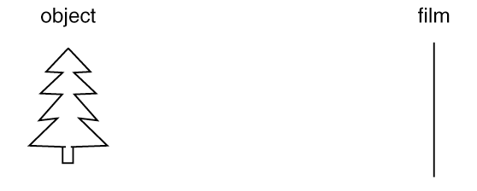
Camera: Forming an image
Last lecture: we built a 3D geometric world
Now, we need some sort of sensor to receive and record a picture.
Is this all we need?
Do we get a useful image?

Slide 4
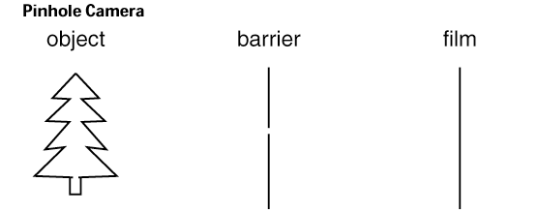
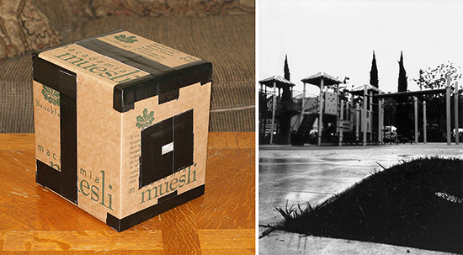
Pin-hole Camera
a hole
Advantages:
  easy to simulate
  everything is in focus
Disadvantages:
  needs a bright scene (or long exposure) – in real life
  everything is in focus (no depth of field) – (not realistic in terms of photography)
Supported by most graphics API

Slide 5
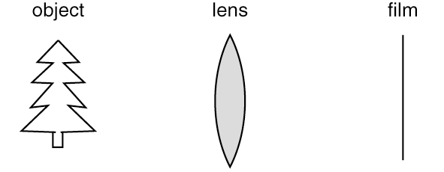
Camera with Lens
focal
point
focal length
Advantages:
  no need to have bright scene - in real life
  not everything is in focus (more realistic in terms of photography)
Disadvantages:
  need more programming to simulate
  not everything is in focus (can only capture objects within a certain depth range)
Not supported by most graphics APIs

Slide 6
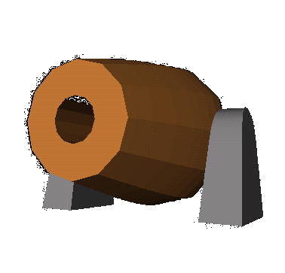

What is a Projection?
From a higher dimension to a lower dimension
  e.g. from n-space to m-space such that m < n
So, in 3D computer graphics, usually n=3 and m=2
eye/camera
2D film
3D object

Slide 7
Family of Projections
The taxonomy:
Parallel
Perspective
Orthographic
Oblique:
cavalier & others
Orthogonal:
side, top,
front, etc.
Axonometric:
isometric
& others
[Levoy]
Note: all these are planar projections (other projections: planetarium, etc.)

Slide 8
Parallel VS Perspective Projections
In 3D, we map points from 3-space to the projection plane (PP) along projection lines emanating from the center of projection (COP):
The center of projection (COP) is exactly the same as the pinhole in a pinhole camera
1. Perspective
≡
* Finite distance
between PP and COP
scene
COP
PP (no need ⊥
to center of view)
Pinhole
scene
Film plane
2. Parallel
≡
scene
Observer (COP) at ∞
* Infinite distance
between PP and COP
PP (no need ⊥
to center of view)
[Levoy]

Slide 9

Parallel Projection
In Parallel Projection, we can specify Direction of Projection (DOP)
because all projection lines are parallel.
1. Oblique Projection (DOP NOT perpendicular to PP)
Camera or
eye at infinity
PP
DOP
2. Orthographic Projection (DOP perpendicular to PP)
Camera or
eye at infinity
PP
DOP

Slide 10
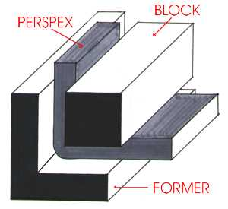
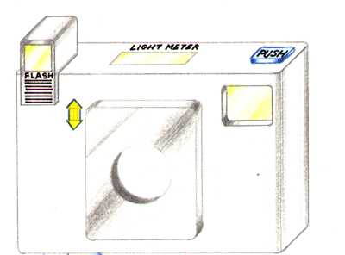
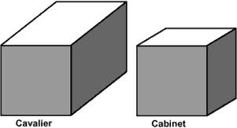
Oblique Projection (parallel)
- It is like shearing the geometry along PP
- Two standards of Oblique Projection:
Examples:
Cavalier Projection
- DOP makes 45º angle with PP
- Does not foreshorten lines perpendicular to PP
- So, it preserves lengths
2. Cabinet Projection
- DOP makes 63.4º angle with PP
- Foreshorten lines perpendicular to PP by one-half

Slide 11
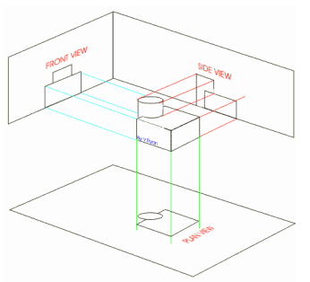
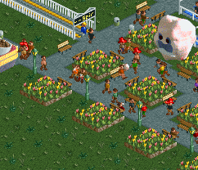
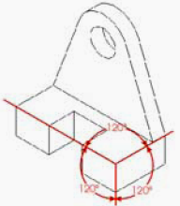
Orthographic Projection (parallel)
Orthogonal Projection
- DOP align with object’s X, Y, or Z axes
- implementation: we can simply throw away the X, Y,
or Z component (put it as zero) of the eye coordinate
- “side”, “top/plan”, or “front” views
2. Axonometric Projection
- arbitrary DOP, not parallel to world X, Y, nor Z axes
- special case: isometric (exactly 120º)
Example:
After projecting to the 2D image, the original x,y,z axes in the 3D world are 120º from each other on the 2D image
Example
(isometric):
Simulation
Games

Slide 12
Parallel Projection
Properties of parallel projection:
Not realistic looking
Good for exact measurements
Most often used in CAD, architecture drawings,
etc., where taking exact measurement is important

Slide 13
Perspective Projection
How we see nature
Points farther away become smaller
scene
COP
PP (no need ⊥
to center of view)

Slide 14
Summary: Projections
The taxonomy:
COP at infinity ?
Y
N
Parallel
Perspective
DOP ⊥ PP ?
Y
N
Orthographic
Oblique:
cavalier & others
DOP // XYZ axes ?
Y
N
Orthogonal:
side, top,
front, etc.
Axonometric:
isometric
& others
[Levoy]

Slide 15
Projection in OpenGL
Specifying projection:
The Viewing Frustum
3D scene
(Not Clipped)
Observer:
Camera or eye
top clipping plane
Central ray
(direction of view)
Projection plane
bottom clipping plane
hither (near
clipping plane)
yon (far
clipping plane)

Slide 16
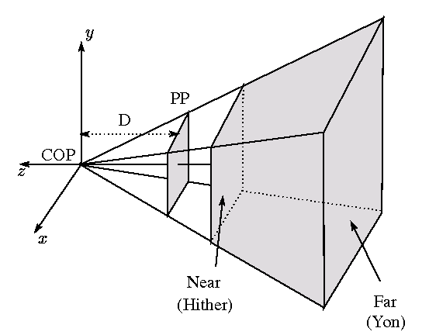
Projection in OpenGL
OpenGL Projection Settings:
Eye/Camera position: Origin
Viewing direction: Negative Z-axis
View-up direction: Positive Y-axis
Viewing region (viewing frustum):
between near and far clipping planes
between bottom and top clipping planes
between left and right clipping planes
5. Visible depth range: Hither-yon distance
-Z axis
(i.e. view-up)

Slide 17
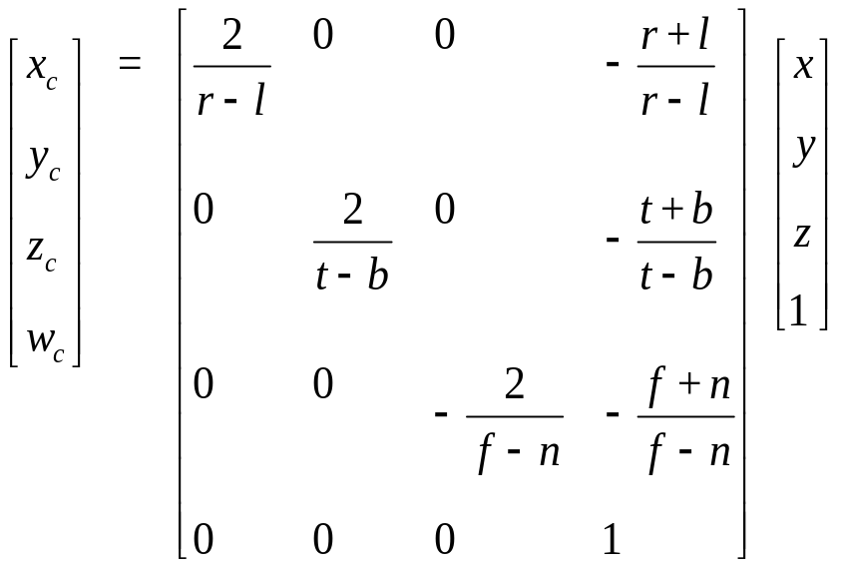
Orthographic Projection in OpenGL
glOrtho(l,r,b,t,n,f) or gluOrtho2D(l,r,b,t)
Left/right/bottom/top/near/far
gluOrtho2D: near = 0 and far = 1
view-up
PP
Near
(Hither)
Far
(Yon)
Clip
coordinate
Eye coordinate
(after Modelview
transformation)
Projection Matrix
(Orthographic)

Slide 18
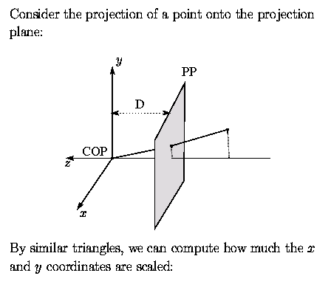
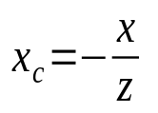
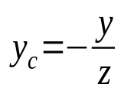
Perspective Concept in OpenGL
Consider the projection of a point onto the
projection plane:
Y
(x,y,z)
(x_{c},y_{c},-1)
Eye
(origin)
-Z
-1
z
Eye coordinate
By similar triangles: and

Slide 19
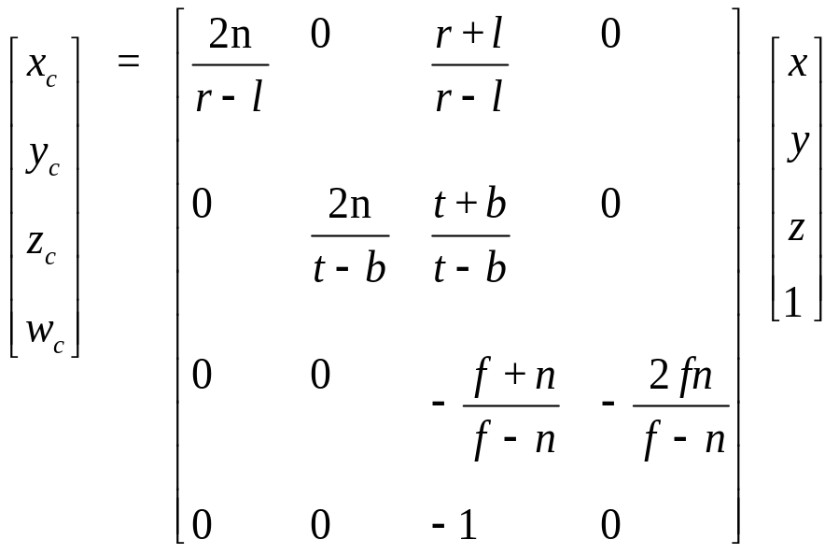
Perspective Projection in OpenGL
How about z_{c}?
We need it for hidden-surface removal
The smaller z_{c} is, the closer the clip coordinate is from the eye (note: Z is flipped after this matrix multiplication)
We use glFrustum(l,r,b,t,n,f).
Clip
coordinate
Eye coordinate
(after Modelview
transformation)
Projection Matrix
(Perspective)

Slide 20
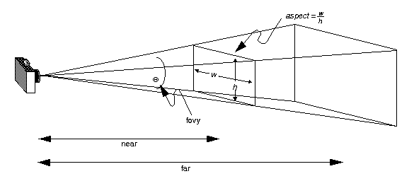
Perspective Projection in OpenGL
glFrustum is less intuitive, we can use gluPerspective to
specify a perspective viewing frustum in most cases:
gluPerspective ( fovy , aspect , near , far )
fovy is vertical field-of-view and aspect is width/height ratio
This function also constructs a projection matrix like glFrustum. (see red book for details)

Slide 21
Projection in OpenGL
Sample Code about specifying the projection matrix:
glMatrixMode ( GL_PROJECTION ) ; // switch the matrix mode
glLoadIdentity() ;
gluPerspective ( 60 , 1.0 , 1.0 , 10.0 ) ;
// near, far must > 0 for perspective
// fovy angle: 60 degrees
glMatrixMode ( GL_MODELVIEW ) ; // switch the mode back

Slide 22
Clipping and Perspective Division
clip
polygon
edge #1
input
polygon
Clip against
edge #1
3
1
2
Clip against
edge #2
1
edge #2
2
3
[Levoy]

Slide 23
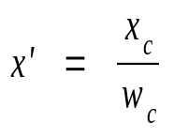
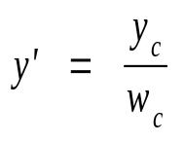
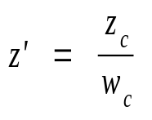

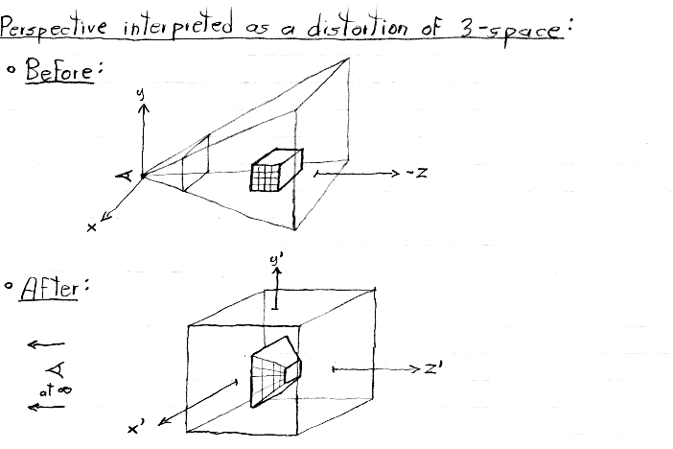
Clipping and Perspective Division
Perspective Division
(or homogenization):
Note that:
Why do this: Make perspective distortion work (i.e., distant objects should appear smaller)
Also, we want to normalize coordinate to [-1, 1] (we call this normalized device coordinate)
Result: Dividing the x’ and y’ by w_c (i.e., -z) makes farther coordinates move close to (0, 0).
So distant objects appear smaller
“Perspective” interpreted as a distortion of 3-space, i.e., view frustum
Before:
View frustum
Eye space
Corresponding, like “stretching”
View frustum after transformation
After:
this far side becomes smaller after perspective division
NDC Space
[-1,+1] along X/Y/Z
at infinity
[Levoy]

Slide 24
Conclusion
Family of Projections (parallel and perspective, oblique
and orthographic, etc.)
Projection Models in OGL (Orthographic and Perspective)
Projection Mechanism in OGL:
  Eye coordinate to Clip coordinate (Projection Matrix)
  Clipping
  Perspective Division (homogenization)
  Also: Viewport transformation: to window coordinates
  (see glViewport)
Your window
viewport

Slide 25
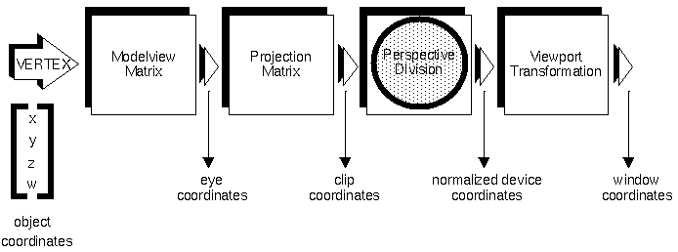
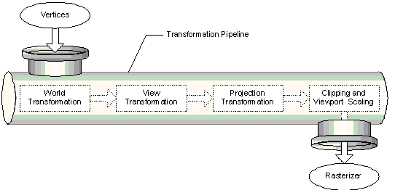
Conclusion
OpenGL API
(from Red book):
DirectX API
(from MSDN):
Why OGL and DirectX
looks the same?
Same GFX Hardware!!!

Slide 26
More: The use of gluLookAt
  gluLookAt ( eyex, eyey, eyez, centerx, centery, centerz, upx, upy, upz )
  (eyex, eyey, eyez) defines location of the camera
  (centerx, centery, centerz) defines the lookat position
  (upx, upy, upz) defines the viewup vector
  Note:
  This function is a bit confusing because it seems to violate the
  OGL concept that the camera is always at the eye-space origin
  In fact, it inverses the transformation by constructing an inverse
  matrix that transforms the whole world against the camera inversely
viewup
center
in the world
eye
Implementation hint:
Check “rotation as frames” in 3d transformation slides
(To mimic the case when the camera is rotated, you can instead rotate the world by the inverse of the matrix that aligns the world coordinate frame with the camera coordinate frame)

Slide 27
Example
  // the following code constructs a world with a point at the origin, “moves” the camera to (0,0,5), and renders what’s being seen by the camera through a perspective projection
  glMatrixMode(GL_PROJECTION);
  glLoadIdentity();
  gluPerspective(50.0, 1.0, 3.0, 7.0); //set the camera (perspective) projection matrix
  glMatrixMode(GL_MODELVIEW);
  glLoadIdentity();
  gluLookAt(0.0, 0.0, 5.0, 0.0, 0.0, 0.0, 0.0, 1.0, 0.0); // “move” the camera (in fact transforming the world against the camera inversely;)
  glPushMatrix()
  glBegin(GL_POINTS)
  glVertex3f(0,0,0); //draw a point at the origin
  glEnd()
  glPopMatrix()

Slide 28
Detailed Math Derivation
  See:
  http://www.songho.ca/opengl/gl_projectionmatrix.html

